Slide 1
Architecture chaine DevOps

Slide 2


New sources

Slide 3

Git Push
Git/Sources
New sources

Slide 4

Git Pull
Git/Sources
Serveur Jenkins
New sources

Slide 5


Build
Git/Sources
Serveur Jenkins
New Build

Slide 6

Tests
Git/Sources
New Build

Slide 7
Git Push
Git/Sources
Git/Bin
New sources
New Build

Slide 8
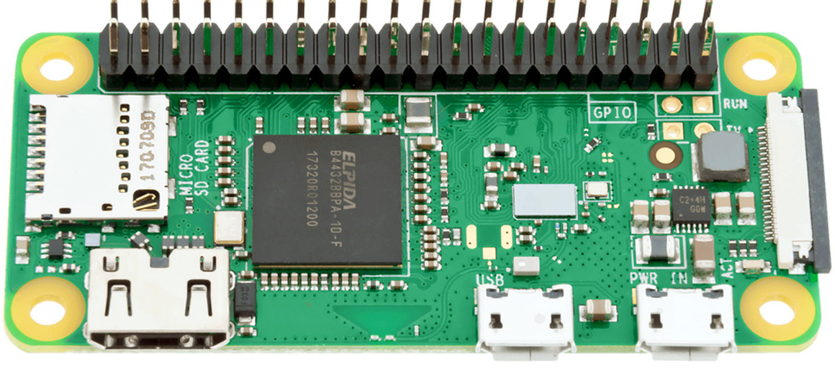

New Build
Ansible Pull
Ansible Pull
New Build
Ansible Pull
New Build
Git/Bin
Ansible Pull
New Build

